Slide 1

Dig245 final project
Jordan Reed

Slide 2
Final project
For my final project I decided to focus on the topic of usability and how it can affect the user experience. I demonstrate this by asking the user to view two websites and the “grade” them.

Slide 3
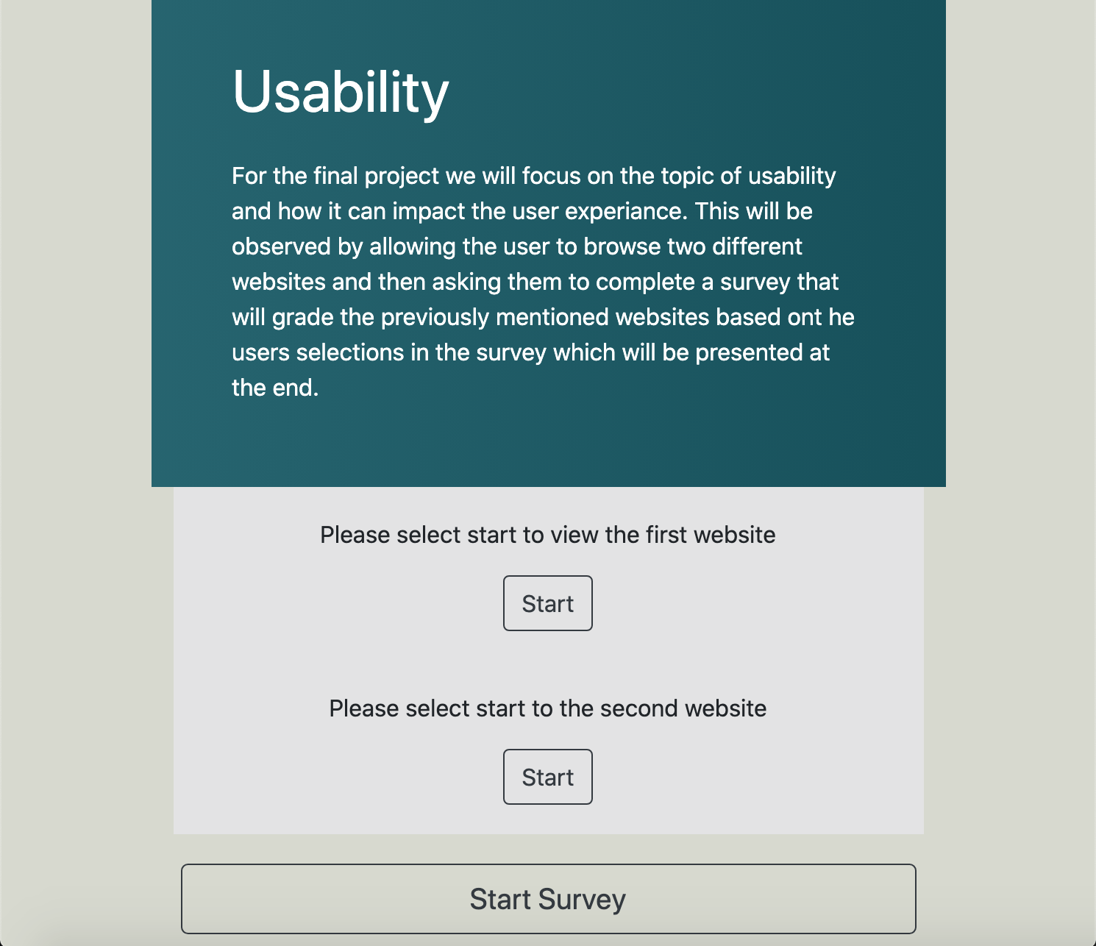
Home page
When the user first opens the website, they will be greeted with a short introduction and some instruction.

Slide 4
The two websites

Slide 5
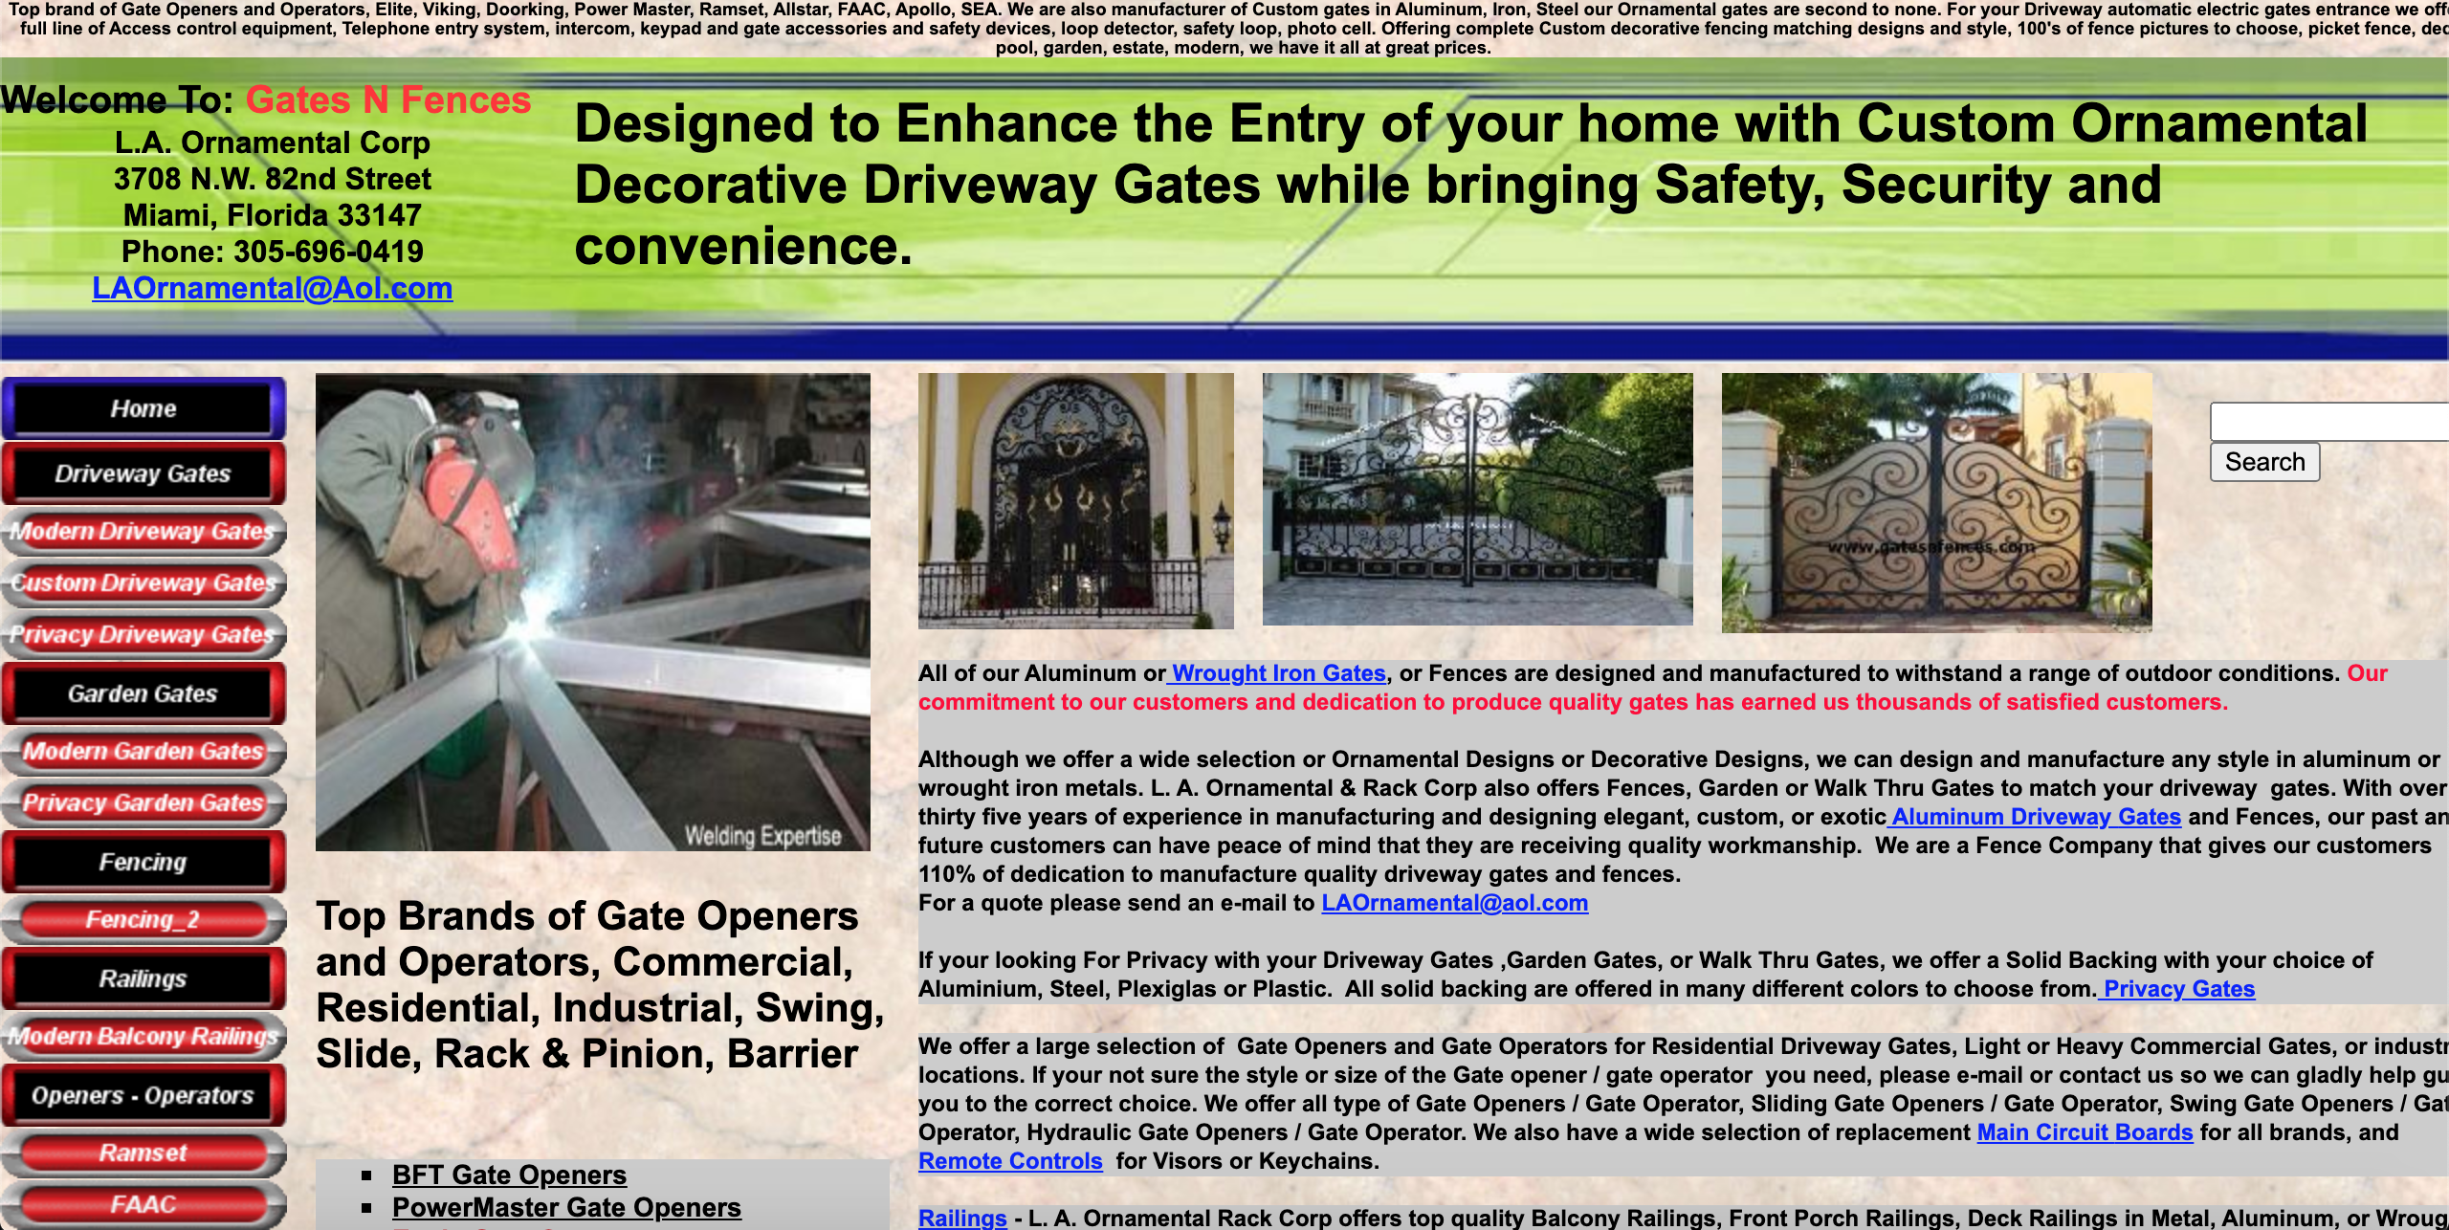

Slide 6


Slide 7
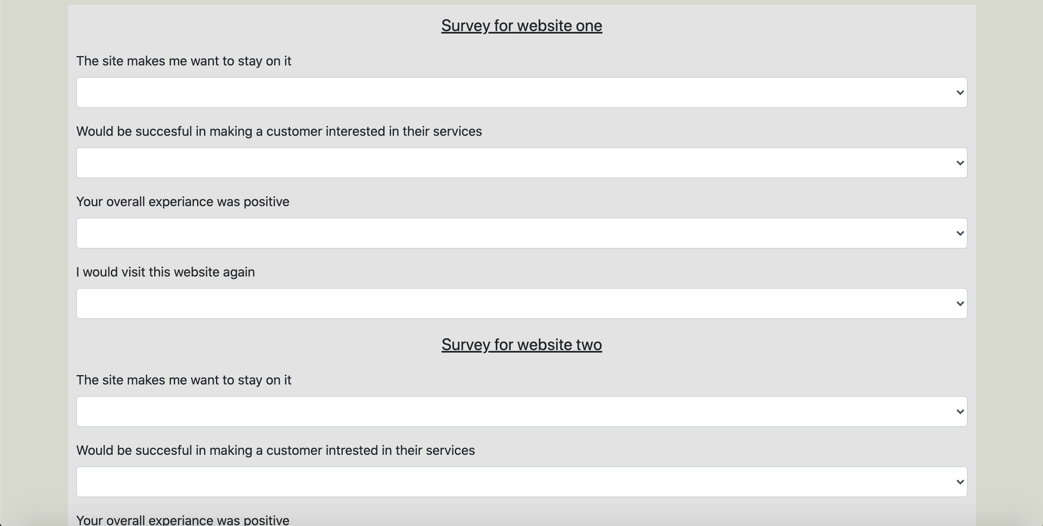
Survey
Here is the survey that the user will be asked to complete.

Slide 8
Results
Here is the results section that displays the grade for both sites.

